Slide 1
NeurIPS 2022 Summary
Optimizing
Diffusion
Analysis of Design Space
& Performance Improvements
Tero Karras, Miika Aittala
Timo Aila, Samuli Laine
NVIDIA

Slide 2
Table of Contents
01. Introduction and Framework
03
02. Sampling Improvements
07
03. Training and Architecture
10
04. Results and Conclusion
13

Slide 3
SECTION
Introduction
01
and Framework

Slide 4
Introduction and Framework
Current Challenges in Diffusion Model Theory
Diffusion-based generative models now surpass GANs in image synthesis quality, yet they suffer
from unnecessarily convoluted theory and complex implementation practices.
Core Challenge
Practical Implication
Tightly Coupled
Architectures
Literature presents models as monolithic packages,
obscuring distinct design choices.
Abstract Theoretical
Frameworks
Derivations rely on complex statistical processes
rather than practical, tangible algorithms.
Rigidity &
Fragility
Complexity creates barriers where modifying specific components
risks breaking the entire system logic.
Obscured Performance
Attribution
It remains unclear which individual design choices
specifically drive performance gains.
Optimizing Diffusion-Based Generative Models

Slide 5
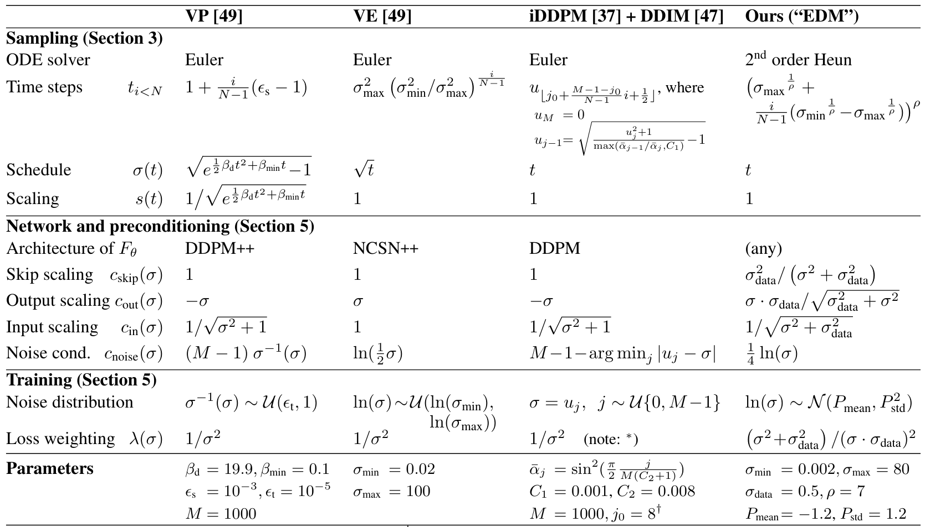
Introduction and Framework
Proposed Design Space Methodology
De-coupling Design Choices
Current literature often presents models as tightly coupled packages.
We propose a modular 'design space' that clearly separates choices.
This isolates sampling, training, and score network preconditioning.
Focus on Tangible Objects
We prioritize practical algorithms over abstract statistical theory.
By focusing on "tangible" objects, we expose hidden degrees of
freedom available in the system's design without breaking it.
Reframing Prior Methods
We re-express VP, VE, and iDDPM methods within this unified view.
This reveals specific oversights and allows for component-level
optimization. For example, replacing Euler solvers with Heun.
Performance Impact
These changes yield a state-of-the-art FID of 1.79 on CIFAR-10.
Sampling is accelerated to just 35 evaluations per image.
Comparative Analysis
Table 1 contrasts our "EDM" approach with VP, VE, and iDDPM.
We identify optimal parameters like M=1000 and σ_min=0.002.
The 2nd order Heun solver replaces basic Euler methods.
This systematic analysis enables drop-in improvements.
Optimizing Diffusion-Based Generative Models

Slide 6
Introduction and Framework
Unified ODE Formulation
The framework utilizes a probability flow Ordinary Differential Equation (ODE) where samples evolve over time to match the data distribution.
This approach allows for the separation of the time schedule and scaling from the training of the neural network itself.
Theoretical Foundations
Design Innovations
The probability flow ODE evolves samples deterministically.
It transforms initial noise into the target data distribution.
A noise schedule defines the desired noise level at time t.
Constant-speed heat diffusion is mathematically natural.
The score function vector field points to higher data density.
It directs updates based on the rate of change in noise levels.
We explicitly separate the time schedule from network training.
This design choice facilitates easier component innovation.
Denoising score matching minimizes expected L2 denoising error.
This method bypasses intractable normalization constants.
Solving the ODE involves numerical integration over time.
Our 2nd order solver improves the computational tradeoff.
Forward steps nudge samples away from the data distribution.
Backward steps guide samples towards the data distribution.
Time-dependent signal scaling generalizes the ODE solution.
Scaling is undone during score evaluation to preserve logic.
Optimizing Diffusion-Based Generative Models

Slide 7
SECTION
Sampling
02
Optimizing Diffusion-Based Generative Models

Slide 8
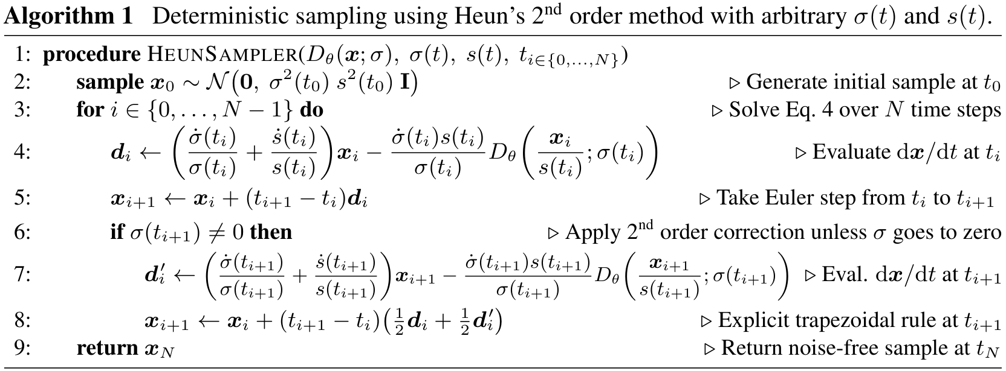
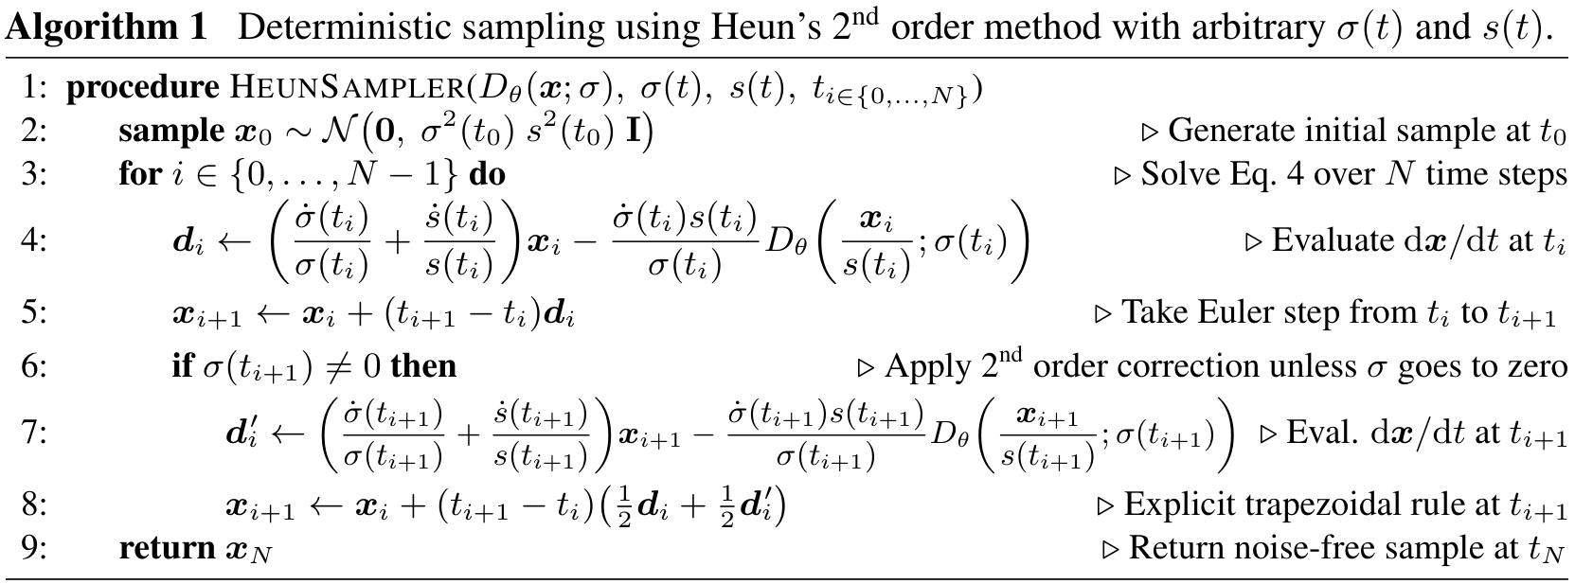
Higher-order numerical solvers can significantly improve image quality while reducing computational cost.
Deterministic Sampling Improvements
Heun's 2nd order method introduces a correction step to reduce local truncation error.
Heun's 2nd Order Method
This approach improves upon Euler's
method by adding a correction step
that accounts for derivative changes.
Algorithm Procedure
The solver initializes a sample and
iterates through N time steps. It
calculates the derivative at the
current step, performs an Euler
update, and applies a second-order
correction using the trapezoidal
rule to reduce local error.
Performance Tradeoff
While Heun's method requires two
function evaluations per step (vs.
one for Euler), it significantly
reduces truncation error. This
allows for fewer total steps to
achieve comparable image quality,
ultimately improving efficiency.
Results show Heun's method matches Euler's FID scores with far fewer sampling steps.
Optimizing Diffusion-Based Generative Models

Slide 9
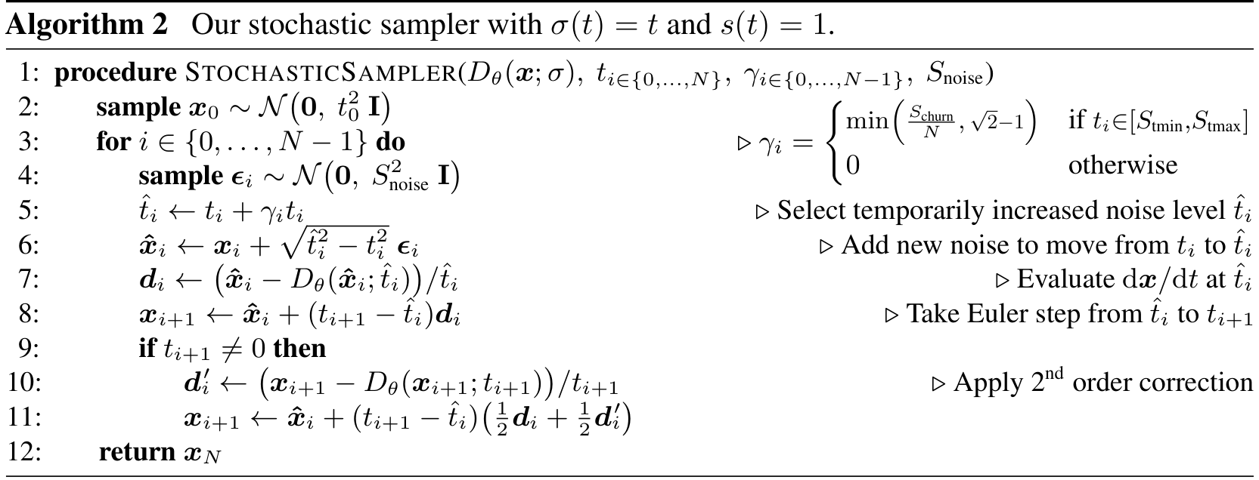
Sampling Improvements
Stochastic Sampling Strategy
Stochastic Mechanism combines a 2nd order ODE integrator with
explicit Langevin-like churn to inject and remove noise. As shown
in Algorithm 2, we first add noise to reach a temporary level t̂i.
We then solve the ODE backward from t̂i to the next level ti+1. This
alternating process maintains the correct distribution while allowing
the sampler to correct approximation errors from prior steps.
Practical Tuning is critical, as excessive noise causes detail loss.
We observed that stochasticity is most beneficial at specific noise
levels. Therefore, we restrict churn to the range [Stmin, Stmax].
By clamping the churn rate γi, we prevent oversaturation.
Experiments confirm this strategy outperforms previous samplers
like Euler-Maruyama, especially when using limited step counts.
Algorithm 2 outlines the alternating noise injection steps.
Optimizing Diffusion-Based Generative Models

Slide 10
SECTION
Training & Arch.
03
Optimizing Diffusion-Based Generative Models

Slide 11
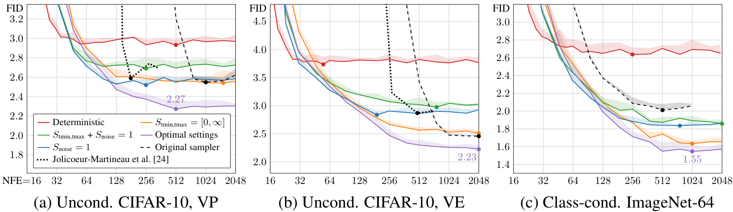
Training and Architecture
Network Preconditioning Best Practices
Benchmark Success
Optimal settings yield
the lowest FID values,
consistently beating
baseline methods.
Performance Metrics
Uncond. CIFAR-10 VP:
Achieved 2.27 FID
Class-cond. ImageNet:
Reached 1.55 FID
Training Robustness
Preconditioning helps
standardize inputs to
unit variance.
Comparative Gains
New state-of-the-art
results surpass the
previous 1.85 record.
Gradient Instability
Training on raw noise levels causes unstable
gradients as signal magnitudes vary with
noise level. Magnitudes fluctuate immensely,
making direct modeling of D less ideal.
Principled Preconditioning
Our scheme scales inputs and outputs to
unit variance for consistency. The network
adaptively estimates a mix of signal and
noise, stabilizing the effective target.
Optimizing Diffusion-Based Generative Models

Slide 12
Training and Architecture
Training Distribution and Augmentation
Strategic improvements to noise distribution and data augmentation enhance training stability and generation quality on diverse datasets.
Training diffusion models efficiently requires balancing noise perception and dataset constraints. We introduce targeted optimizations that
focus learning on recognizable structures and prevent overfitting through conditioned augmentation, achieving new state-of-the-art FID scores.
Analysis of per-noise loss reveals that learning is most
effective at intermediate levels. At very low levels, noise is
negligible, while high noise targets approach the dataset
average and lack discernable structure.
Overfitting is a common challenge for diffusion models trained
on small datasets like CIFAR-10. Standard augmentation methods
often leak into generation, causing the model to produce
undesirable transformed images during inference.
We propose a log-normal distribution for training noise to
target the relevant range. This focuses computational effort
where image structure is recognizable, ignoring irrelevant
extremes to improve training efficiency.
We use non-leaking augmentation by conditioning the network
on transformation parameters. Setting these inputs to zero
during inference ensures clean outputs. This achieved a new
state-of-the-art FID of 1.79 on conditional CIFAR-10.
Optimizing Diffusion-Based Generative Models

Slide 13
SECTION
Results
04
and Conclusion

Slide 14
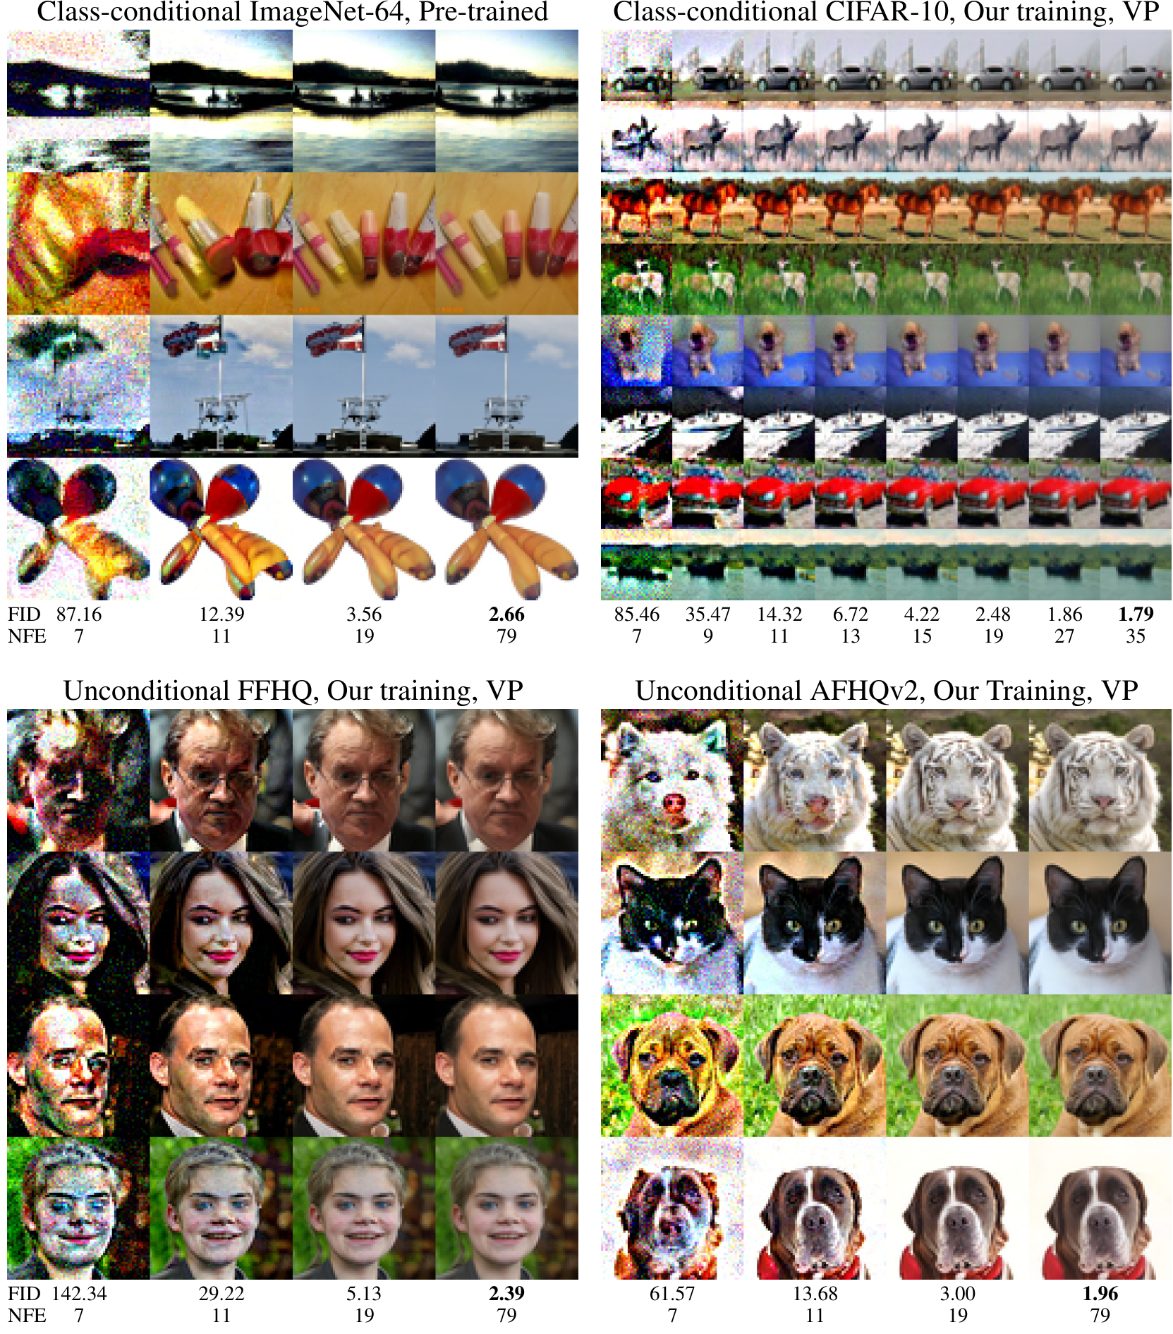
Results and Conclusion
Efficiency Improvements: NFE vs. Quality
The proposed deterministic sampler drastically reduces the
number of function evaluations (NFE) required to reach
high-quality results. By decoupling sampling from training,
we demonstrate that efficiency improvements are consistent
across architectures (VP, VE, iDDPM), proving modularity.
Performance Metrics
For the ImageNet-64 model, the new sampler achieves an
FID of 1.36 using only 79 evaluations, a fraction of the cost
of previous methods. This is driven by Heun's 2nd order method.
Computational Speed
Efficiency gains translate directly to throughput. High-quality
CIFAR-10 images can be generated at a rate of 26.3
images per second on a single NVIDIA V100 GPU. This speed
enables practical real-time applications.
Visual Synthesis Evolution
NFE 7 to 79 Comparison
Visual analysis confirms reasonable quality appears at NFE 19,
with fine details refining further until NFE 79.
Optimizing Diffusion-Based Generative Models

Slide 15
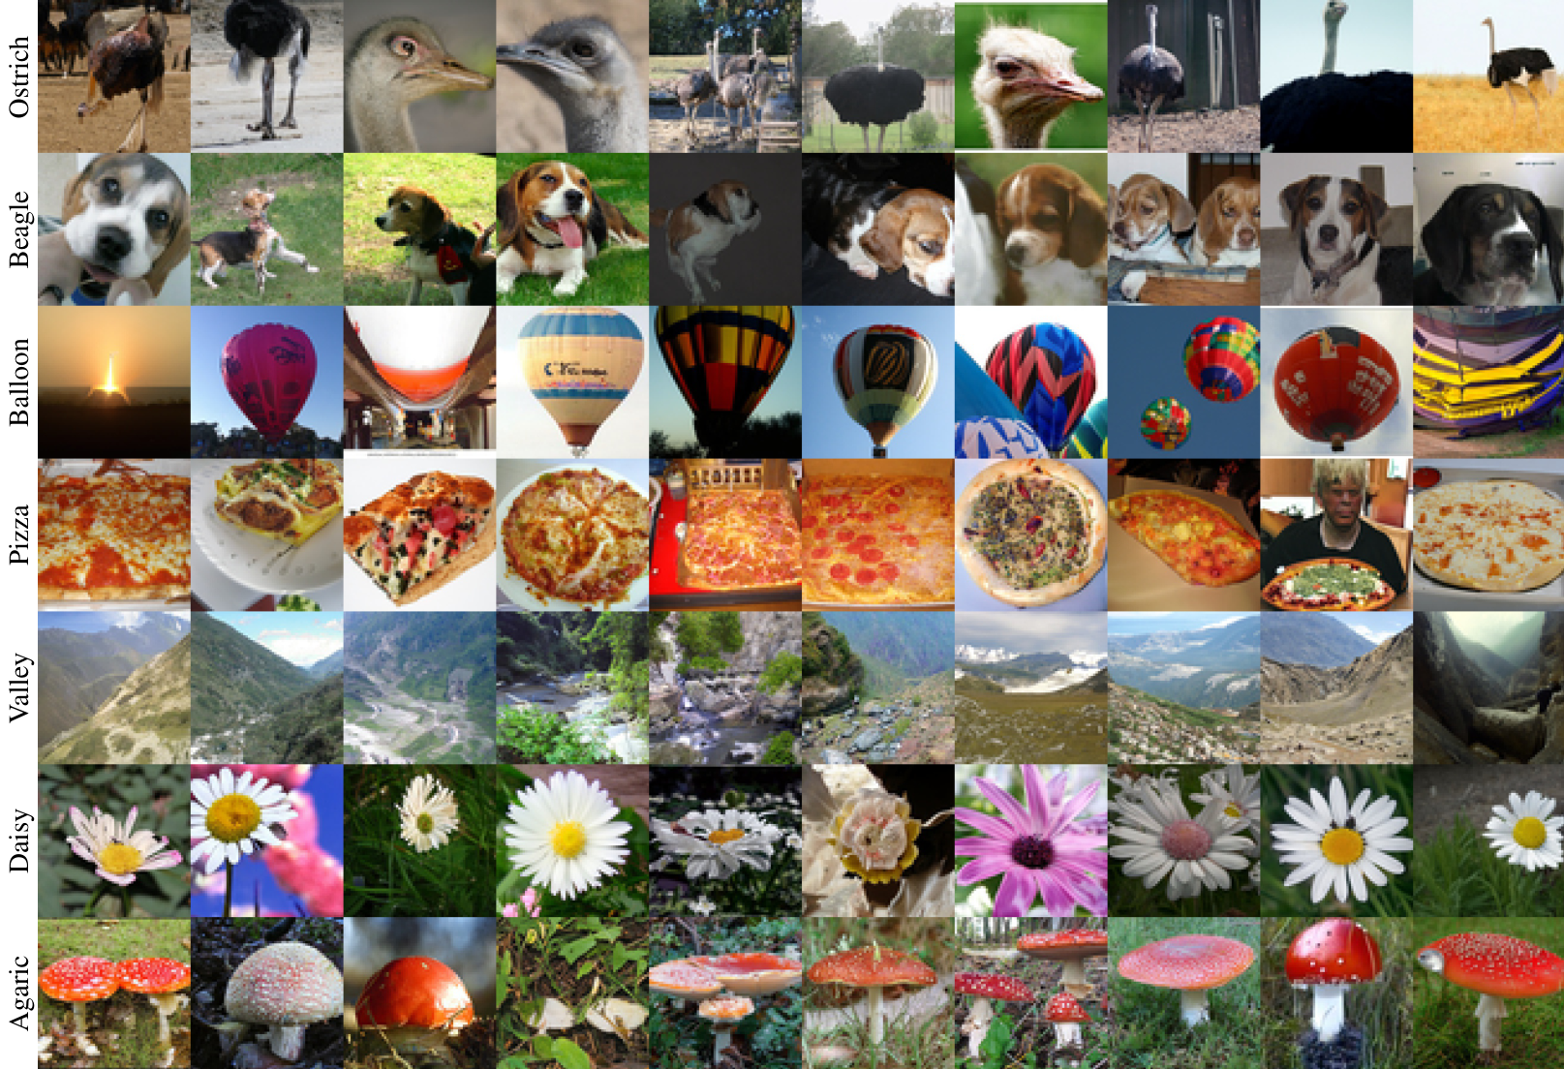
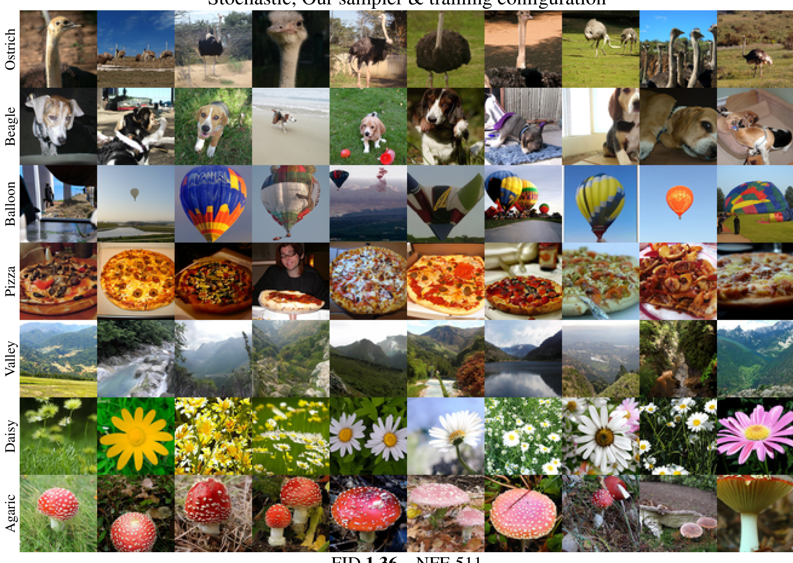
Our combined improvements in sampling and training establish new State-of-the-Art (SOTA) records for diffusion models, markedly lowering FID scores on standard benchmarks.
State-of-the-Art Benchmarks
CIFAR-10 Records
Conditional FID: 1.79
Unconditional FID: 1.97
Surpasses previous best of 1.85
and 2.10 respectively.
ImageNet-64 Stats
Pre-trained Improvement:
FID 2.07 → 1.55
Re-trained SOTA FID:
1.36 (Stochastic)
Efficiency Gains
Sampling Steps Required:
35 (vs hundreds)
NFE Range:
79 (Determ.) to 511
CIFAR-10 Breakthroughs
We achieved an FID of 1.79 in the class-
conditional setting and 1.97 in the
unconditional setting. These results beat
previous records of 1.85 and 2.10.
Training Dynamics
To prevent overfitting on small datasets,
we utilized non-leaky augmentation.
This ensures robust generation quality.
ImageNet-64 Performance
Solely through better sampling, we
improved a pre-trained model's FID
from 2.07 to 1.55.
Stochastic Sampling
Training from scratch with our stack
yielded a new record FID of 1.36.
The visuals below show the diversity
across classes like Ostrich and Beagle.
Optimizing Diffusion-Based Generative Models

Slide 16
Results and Conclusion
Conclusion and Strategic Impact
We disentangle the diffusion model design space, allowing independent upgrades to sampling and training components without breaking the system.
Modular Design Space
Framework
Efficiency and
SOTA Quality
Stochastic Sampling
Dynamics
Broader Impact &
Future Work
The authors propose a clearly
separated design space. This
approach allows researchers
to isolate and upgrade
specific components like
sampling schedules or noise
distributions independently.
Crucially, the new sampler
acts as a drop-in replacement
for existing models,
improving efficiency without
requiring costly retraining.
The improvements yield new
state-of-the-art results.
For CIFAR-10, the model
achieves an FID of 1.79 using
only 35 evaluations.
On ImageNet-64, applying
the sampler to a pre-trained
model improved FID from
2.07 to 1.55, and
retraining reached 1.36.
This outperforms previous
benchmarks significantly.
The role of stochasticity
varies by data complexity.
For simpler datasets like
CIFAR-10, it can be harmful
under optimized training.
However, for complex data
such as ImageNet-64,
stochastic sampling remains
beneficial. This suggests
that diverse datasets
continue to benefit from
randomness in the process.
These contributions are
orthogonal to methods like
super-resolution or large
networks. Future work may
need parameter adjustments
for higher resolutions.
The project consumed
~250MWh of energy.
While quality improves,
societal risks include
disinformation and bias
amplification in media.
Flexible Integration
Record-Breaking Speed
Data-Dependent Value
Sustainability Focus
Optimizing Diffusion-Based Generative Models

